Slide 1
DES-Data Encryption Standard (DES)
Symmetric Encryption Algorithms

Slide 2
Cryptography
The type of operations used for transforming plaintext to ciphertext. All encryption algorithms are based on two general principles:
  Substitution : mapped into another element
  Transposition : plaintext are rearranged.
The number of keys used.
  symmetric, single-key, secret-key, or conventional encryption.
  asymmetric, two-key, or public-key encryption.
The way in which the plaintext is processed.
  Block Cipher Converts the plain text into cipher text by taking plain text’s block at a time.
  Stream Cipher Converts the plain text into cipher text by taking 1 byte of plain text at a time.

Slide 3
Symmetric Encryption
or conventional / private-key / single-key
sender and recipient share a common key
all classical encryption algorithms are private-key
was only type prior to invention of public-key in 1970’s
and by far most widely used
Notes:
Symmetric encryption, also referred to as conventional encryption or single-key encryption, was the only type of encryption in use prior to the development of public-key encryption in the 1970s. It remains by far the most widely used of the two types of encryption. All traditional schemes are symmetric / single key / private-key encryption algorithms, with a single key, used for both encryption and decryption. Since both sender and receiver are equivalent, either can encrypt or decrypt messages using that common key.

Slide 4
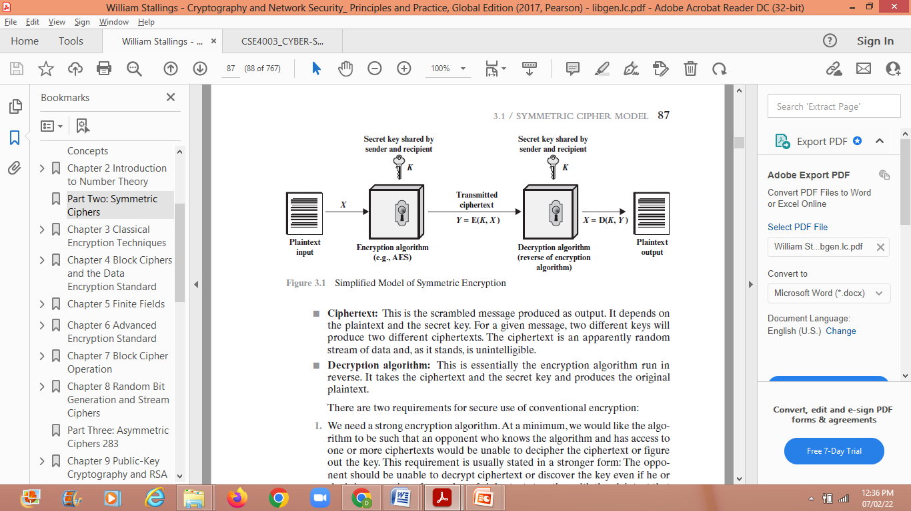
Symmetric Cipher Model

Slide 5
Data Encryption Standard (DES)
most widely used block cipher in world
Adopted in 1977 by NBS (now National Institute of Standards Technology NIST)
  as FIPS PUB 46
encrypts 64-bit data using 56-bit key
Has widespread use
Notes:
The most widely used private key block cipher, is the Data Encryption Standard (DES). It was adopted in 1977 by the National Bureau of Standards as Federal Information Processing Standard 46 (FIPS PUB 46). DES encrypts data in 64-bit blocks using a 56-bit key. The DES enjoys widespread use. It has also been the subject of much controversy its security.

Slide 6
DES History
IBM developed Lucifer cipher
  by team led by Feistel in late 60’s
  used 64-bit data blocks with 128-bit key
Then redeveloped as a commercial cipher with input from National Security Agency(NSA) and others
In 1973 NBS issued request for proposals for a national cipher standard
IBM submitted their revised Lucifer which was eventually accepted as the DES
Notes:
In the late 1960s, IBM set up a research project in computer cryptography led by Horst Feistel. The project concluded in 1971 with the development of the LUCIFER algorithm. LUCIFER is a Feistel block cipher that operates on blocks of 64 bits, using a key size of 128 bits.
Because of the promising results produced by the LUCIFER project, IBM embarked on an effort, headed by Walter Tuchman and Carl Meyer, to develop a marketable commercial encryption product that ideally could be implemented on a single chip. It involved not only IBM researchers but also outside consultants and technical advice from NSA. The outcome of this effort was a refined version of LUCIFER that was more resistant to cryptanalysis but that had a reduced key size of 56 bits, to fit on a single chip.
In 1973, the National Bureau of Standards (NBS) issued a request for proposals for a national cipher standard. IBM submitted the modified LUCIFER. It was by far the best algorithm proposed and was adopted in 1977 as the Data Encryption Standard.

Slide 7
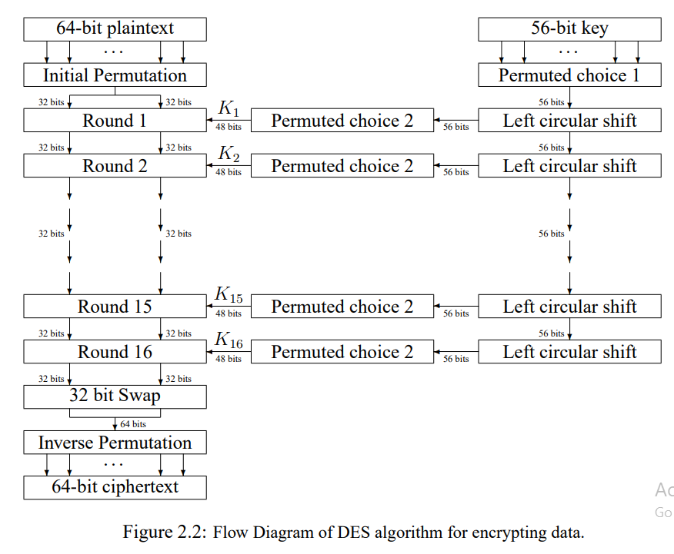
DES Encryption Overview
Notes:
The overall scheme for DES encryption is illustrated in Stallings Figure 3.4, which takes as input 64-bits of data and of key.
The left side shows the basic process for enciphering a 64-bit data block which consists of:
- an initial permutation (IP) which shuffles the 64-bit input block
- 16 rounds of a complex key dependent round function involving substitutions & permutations
- a final permutation, being the inverse of IP
The right side shows the handling of the 56-bit key and consists of:
- an initial permutation of the key (PC1) which selects 56-bits out of the 64-bits input, in two 28-bit halves
- 16 stages to generate the 48-bit subkeys using a left circular shift and a permutation of the two 28-bit halves

Slide 8
Initial Permutation IP
Figure shows the sequence of events that occur during an encryption operation.
DES performs an initial permutation on the entire 64 bit block of data.
It is then split into 2 halves, 32 bit sub-blocks, Li and Ri which are then passed into what is known as a round (see figure), of which there are 16 (the subscript i in Li and Ri indicates the current round).

Slide 9
Each of these permutations takes a 64-bit input and permutes them according to a predefined rule.
Permutation : VIT – TIV – TVI - IVT
These permutations are keyless straight permutations that are the inverse of each other.

Slide 10
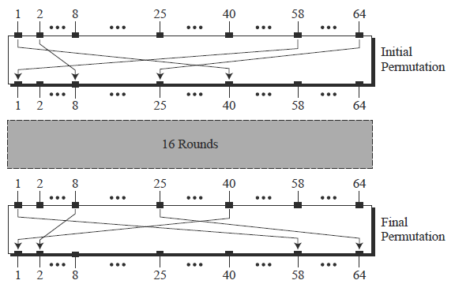
Initial and Final Permutations

Slide 11
Initial and Final Permutations
The reason they are included in DES is not clear and has not been revealed by the DES designers.
The guess is that DES was designed to be implemented in hardware (on chips) and that these two complex permutations may prevent / deny a software simulation of the mechanism.

Slide 12
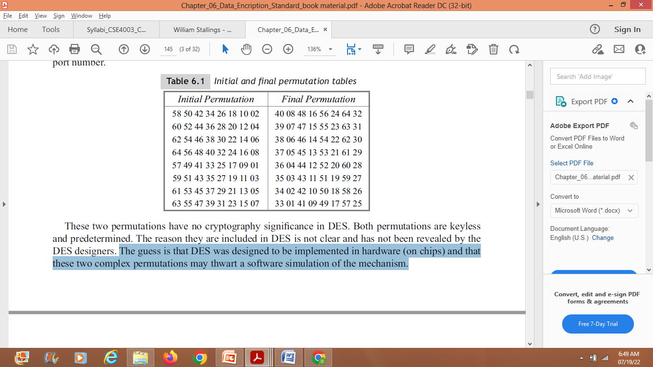
Initial and final(Inverse) permutation tables
This [R16, L16] concatenation is permuted using a function which is the exact inverse of the initial permutation

Slide 13
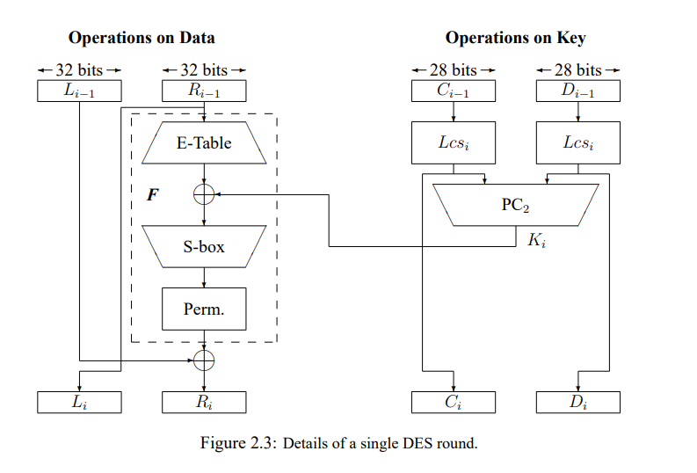
DES Round Structure
Notes:
We now review the internal structure of the DES round function F, which takes R half & subkey, and processes them. The round key K_{i} is 48 bits. The R input is 32 bits. This R input is first expanded to 48 bits by using a table that defines a permutation plus an expansion that involves duplication of 16 of the R bits (Table 3.2c). The resulting 48 bits are XORed with K_{i} This 48-bit result passes through a substitution function that produces a 32-bit output, which is permuted as defined by Table 3.2d. This follows the classic structure for a feistel cipher.
Note that the s-boxes provide the “confusion” of data and key values, whilst the permutation P then spreads this as widely as possible, so each S-box output affects as many S-box inputs in the next round as possible, giving “diffusion”.

Slide 14
The main operations on the data are encompassed into what is referred to as the cipher function and is labeled F.
This function accepts two different length inputs of 32 bits and 48 bits and outputs a single 32 bit number.
Both the data and key are operated on in parallel, however the operations are quite different.
The 56 bit key is split into two 28 bit halves Ci and Di (C and D being chosen so as not to be confused with L and R).
The value of the key used in any round is simply a left cyclic shift and a permuted contraction of that used in the previous round. Mathematically, this can be written as

Slide 15
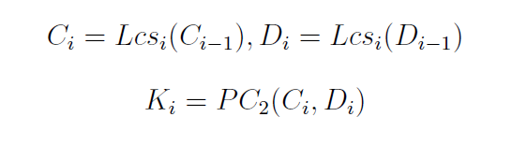
where Lcsi is the left cyclic shift for round i, Ci and Di are the outputs after the shifts,
PC2(.) is a function which permutes and compresses a 56 bit number into a 48 bit number and Ki is the actual key used in round i.
The number of shifts is either one or two and is determined by the round number i. For i = {1, 2, 9, 16} the number of shifts is one and for every other round it is two.

Slide 16
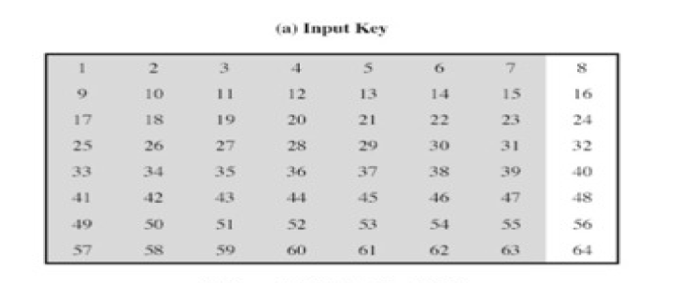
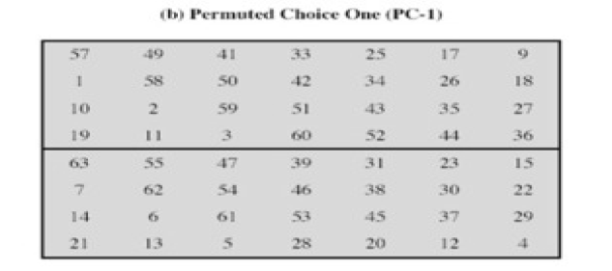
    key rotation schedule K

Slide 17
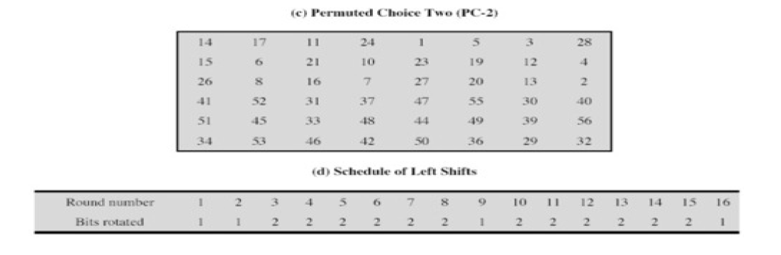
Initially the key is passed through a permutation function (PC1 - defined in table (Above Table)
For each of the 16 iterations, a subkey (Ki) is produced by a combination of a left circular shift and a permutation (PC2 - defined in table previous)
which is the same for each iteration. However, the resulting subkey is different for each iteration because of repeated shifts.

Slide 18
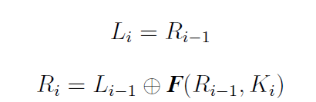
DES Round Structure
The common formulas used to describe the relationships between the input to one round and its output (or the input to the next round) are
F is the main part of every round and consists of four separate stages

Slide 19
STEP 1 - DES ROUND 1- E-BOX
The E-box expansion permutation - here the 32-bit input data from Ri−1 is expanded and permuted to give the 48 bits necessary for combination with the 48 bit key (defined in table).
The E-box expansion permutation delivers a larger output by splitting its input into 8 Nybble, 4-bit blocks and copying every first and fourth bit in each block into the output in a defined manner.
  It copies the end bits of the two adjacent nybbles into the two end bits of the 6-bit block

Slide 20
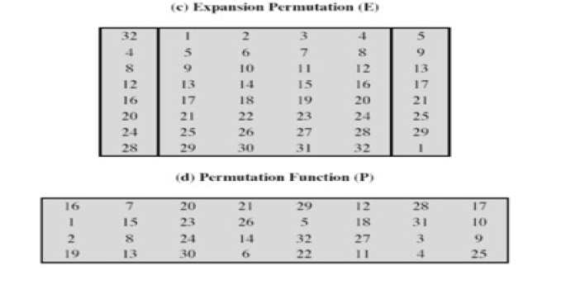
DES Round Structure
Notes:
We now review the internal structure of the DES round function F, which takes R half & subkey, and processes them. The round key K_{i} is 48 bits. The R input is 32 bits. This R input is first expanded to 48 bits by using a table that defines a permutation plus an expansion that involves duplication of 16 of the R bits (Table 3.2c). The resulting 48 bits are XORed with K_{i} This 48-bit result passes through a substitution function that produces a 32-bit output, which is permuted as defined by Table 3.2d. This follows the classic structure for a feistel cipher.
Note that the s-boxes provide the “confusion” of data and key values, whilst the permutation P then spreads this as widely as possible, so each S-box output affects as many S-box inputs in the next round as possible, giving “diffusion”.

Slide 21
STEP 2
The bit by bit addition modulo 2 (or exclusive OR) of the E-box output and 48 bit subkey Ki.
STEP 3
The S-box substitution - this is a highly important substitution which accepts a 48-bit input and outputs a 32-bit number

Slide 22

DES S-BOX Round Structure
Notes:
Stallings Figure 3.7 illustrates the internal structure of the DES round function F. The R input is first expanded to 48 bits by using expansion table E that defines a permutation plus an expansion that involves duplication of 16 of the R bits (Stallings Table 3.2c). The resulting 48 bits are XORed with key K_{i} . This 48-bit result passes through a substitution function comprising 8 S-boxes which each map 6 input bits to 4 output bits, producing a 32-bit output, which is then permuted by permutation P as defined by Stallings Table 3.2d.

Slide 23

Substitution Boxes S
have eight S-boxes which map 6 to 4 bits
Each of the S-boxes can be thought of as a 4 × 16 matrix.
Each cell of the matrix is identified by a coordinate pair (i, j), where
  outer bits 1 & 6 (row bits) select one row of 4
  inner bits 2-5 (col bits) are substituted
Notes:
The substitution consists of a set of eight S-boxes, each of which accepts 6 bits as input and produces 4 bits as output. These transformations are defined in Stallings Table 3.3, which is interpreted as follows: The first and last bits of the input to box Si form a 2-bit binary number to select one of four substitutions defined by the four rows in the table for Si. The middle four bits select one of the sixteen columns. The decimal value in the cell selected by the row and column is then converted to its 4-bit representation to produce the output. For example, in S1, for input 011001, the row is 01 (row 1) and the column is 1100 (column 12). The value in row 1, column 12 is 9, so the output is 1001.
The example lists 8 6-bit values (ie 18 in hex is 011000 in binary, 09 hex is 001001 binary, 12 hex is 010010 binary, 3d hex is 111101 binary etc), each of which is replaced following the process detailed above using the appropriate S-box. ie
S1(011000) lookup row 00 col 1100 in S1 to get 5
S2(001001) lookup row 01 col 0100 in S2 to get 15 = f in hex
S3(010010) lookup row 00 col 1001 in S3 to get 13 = d in hex
S4(111101) lookup row 11 col 1110 in S4 to get 2 etc

Slide 24
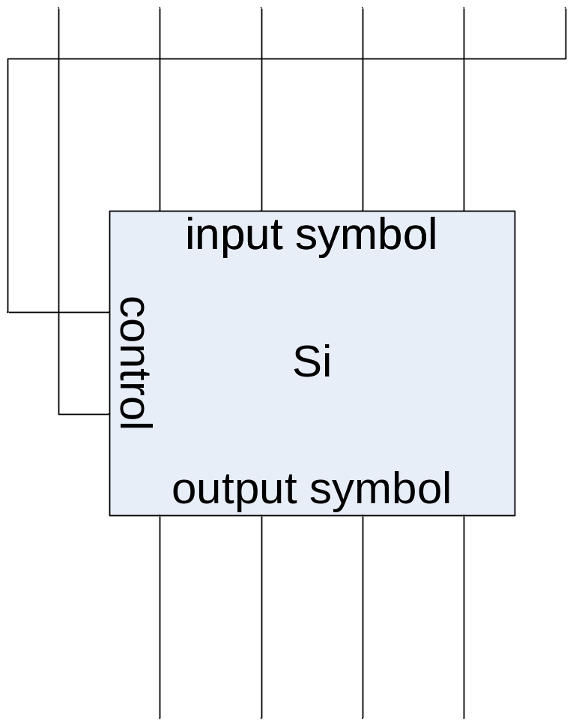
Substitution Boxes S
each of the eight s-boxes is different
Dec(b1b6) = i and the value of j is take from the decimal representation
of the inner four bits that remain, i.e. Dec(b2b3b4b5) = j.
Notes:
The substitution consists of a set of eight S-boxes, each of which accepts 6 bits as input and produces 4 bits as output. These transformations are defined in Stallings Table 3.3, which is interpreted as follows: The first and last bits of the input to box Si form a 2-bit binary number to select one of four subostitutions defined by the four rows in the table for Si. The middle four bits select one of the sixteen columns. The decimal value in the cell selected by the row and column is then converted to its 4-bit representation to produce the output. For example, in S1, for input 011001, the row is 01 (row 1) and the column is 1100 (column 12). The value in row 1, column 12 is 9, so the output is 1001.
The example lists 8 6-bit values (ie 18 in hex is 011000 in binary, 09 hex is 001001 binary, 12 hex is 010010 binary, 3d hex is 111101 binary etc), each of which is replaced following the process detailed above using the appropriate S-box. ie
S1(011000) lookup row 00 col 1100 in S1 to get 5
S2(001001) lookup row 01 col 0100 in S2 to get 15 = f in hex
S3(010010) lookup row 00 col 1001 in S3 to get 13 = d in hex
S4(111101) lookup row 11 col 1110 in S4 to get 2 etc

Slide 25
STEP 4- Permutation Box P
The P-box permutation - This simply permutes the output of the S-box without
changing the size of the data (defined in table).
It is simply a permutation and nothing else. It has a one to one mapping of its input to its output giving a 32 bit output from a 32 bit input

Slide 26
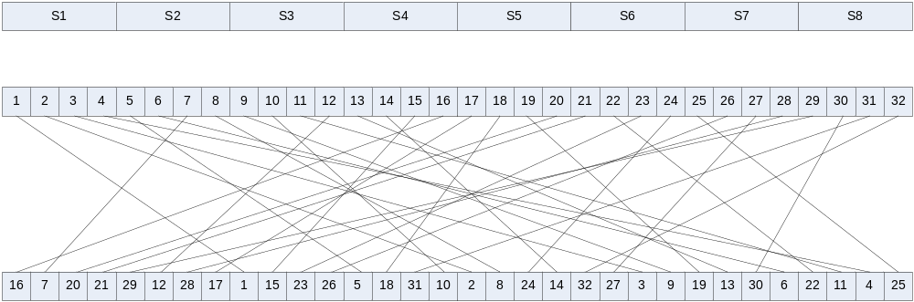
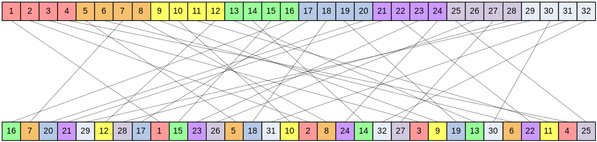
Permutation Box P
P-box at end of each round
Increases diffusion/avalanche effect
Notes:
The substitution consists of a set of eight S-boxes, each of which accepts 6 bits as input and produces 4 bits as output. These transformations are defined in Stallings Table 3.3, which is interpreted as follows: The first and last bits of the input to box Si form a 2-bit binary number to select one of four substitutions defined by the four rows in the table for Si. The middle four bits select one of the sixteen columns. The decimal value in the cell selected by the row and column is then converted to its 4-bit representation to produce the output. For example, in S1, for input 011001, the row is 01 (row 1) and the column is 1100 (column 12). The value in row 1, column 12 is 9, so the output is 1001.
The example lists 8 6-bit values (ie 18 in hex is 011000 in binary, 09 hex is 001001 binary, 12 hex is 010010 binary, 3d hex is 111101 binary etc), each of which is replaced following the process detailed above using the appropriate S-box. ie
S1(011000) lookup row 00 col 1100 in S1 to get 5
S2(001001) lookup row 01 col 0100 in S2 to get 15 = f in hex
S3(010010) lookup row 00 col 1001 in S3 to get 13 = d in hex
S4(111101) lookup row 11 col 1110 in S4 to get 2 etc

Slide 27
DES Decryption
decrypt must unwind steps of data computation
with Feistel design, do encryption steps again using subkeys in reverse order (SK16 … SK1)
  IP undoes final FP step of encryption
  1st round with SK16 undoes 16th encrypt round
  ….
  16th round with SK1 undoes 1st encrypt round
  then final FP undoes initial encryption IP
  thus recovering original data value
Notes:
As with any Feistel cipher, DES decryption uses the same algorithm as encryption except that the subkeys are used in reverse order SK16 .. SK1.
If you trace through the DES overview diagram can see how each decryption step top to bottom with reversed subkeys, undoes the equivalent encryption step moving from bottom to top.

Slide 28
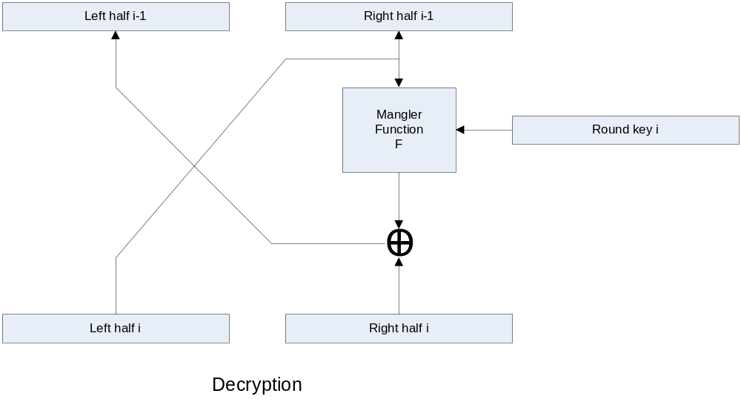
DES Round Decryption
Notes:
As with any Feistel cipher, DES decryption uses the same algorithm as encryption except that the subkeys are used in reverse order SK16 .. SK1.
If you trace through the DES overview diagram can see how each decryption step top to bottom with reversed subkeys, undoes the equivalent encryption step moving from bottom to top.

Slide 29
Avalanche Effect
key desirable property of encryption alg
where a change of one input or key bit results in changing approx half output bits
making attempts to “home-in” by guessing keys impossible
DES exhibits strong avalanche
Notes:
A desirable property of any encryption algorithm is that a small change in either the plaintext or the key should produce a significant change in the ciphertext. In particular, a change in one bit of the plaintext or one bit of the key should produce a change in many bits of the ciphertext. If the change were small, this might provide a way to reduce the size of the plaintext or key space to be searched. DES exhibits a strong avalanche effect, as may be seen in Stallings Table 3.5.

